Slide 1
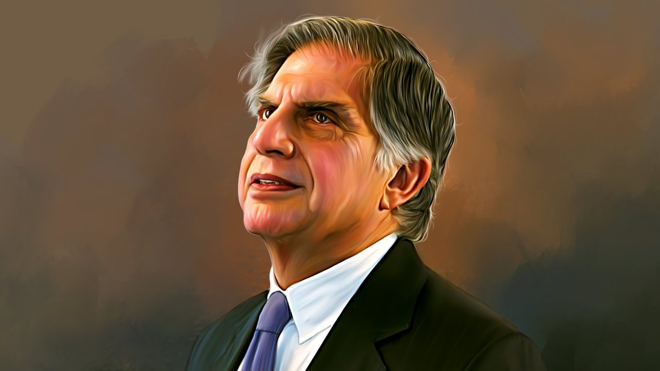

When Less Becomes More
RATAN TATA
By Vardaan

Slide 2
When Less Becomes More
RATAN TATA
By Vardaan

Slide 3





Table of Contents
When Less Becomes More
RATAN TATA
By Vardaan

Slide 4

Table of Contents

Slide 5


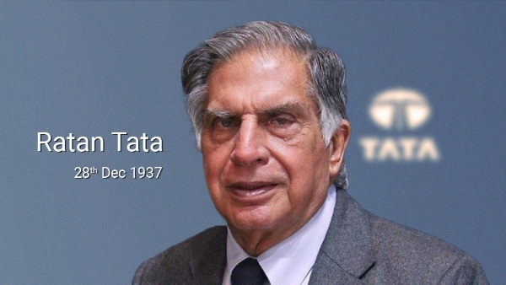
Table of Contents
Who is Ratan Tata
Ratan Tata — Humble. Visionary. Ethical.
Ratan Tata is an Indian industrialist and former Chairman of Tata Sons, known for his quiet leadership, integrity, and people‑first approach. He transformed the Tata Group into a global powerhouse while living a life rooted in simplicity and compassion.

Slide 6

Table of Contents

Slide 7
Table of Contents
When Less is More
Simplicity leads to clarity
He lived a simple, grounded life despite leading a massive business empire, proving that clarity comes from simplicity, not luxury.
Impact without noise
He avoided publicity and let actions speak — especially during crises like 26/11, where he quietly supported victims without media.
Minimalism in leadership
He made fewer but powerful decisions, like the Jaguar Land Rover acquisition, focusing on long‑term impact instead of flashy moves.
Purpose over appearance
He prioritized meaningful work — affordable cars, employee welfare, philanthropy — instead of chasing fame or attention.
Notes:
26 November 2008 Taj Mahal Palace Hotel
Oberoi Trident Hotel
Chhatrapati Shivaji Terminus (CST)
Leopold Café
Nariman House

Slide 8

Table of Contents

Slide 9




Table of Contents
Ratan Tata’s Impact & Legacy
Ratan Tata’s Journey

Slide 10


Table of Contents
Became Chairman in 1991
Modernized the group with a new vision
Faced resistance from older executives
Took over from J.R.D. Tata

Slide 11
Table of Contents
Ratan Tata’s Impact
Modernized the group with a new vision
Became Chairman in 1991
Took over from J.R.D. Tata
Faced resistance from older executives
Notes:
Jehangir Ratanji Dadabhoy Tata

Slide 12
Table of Contents
Became Chairman in 1991
Modernized the group with a new vision
Faced resistance from older executives
Took over from J.R.D. Tata

Slide 13



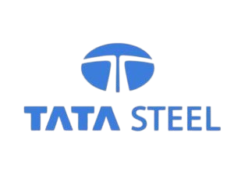





Slide 14
Notes:
Tata Consultancy Services

Slide 16
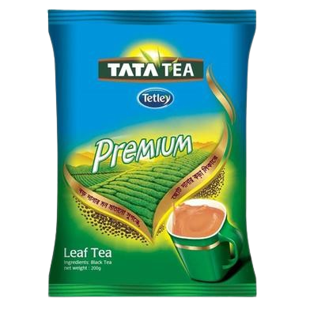
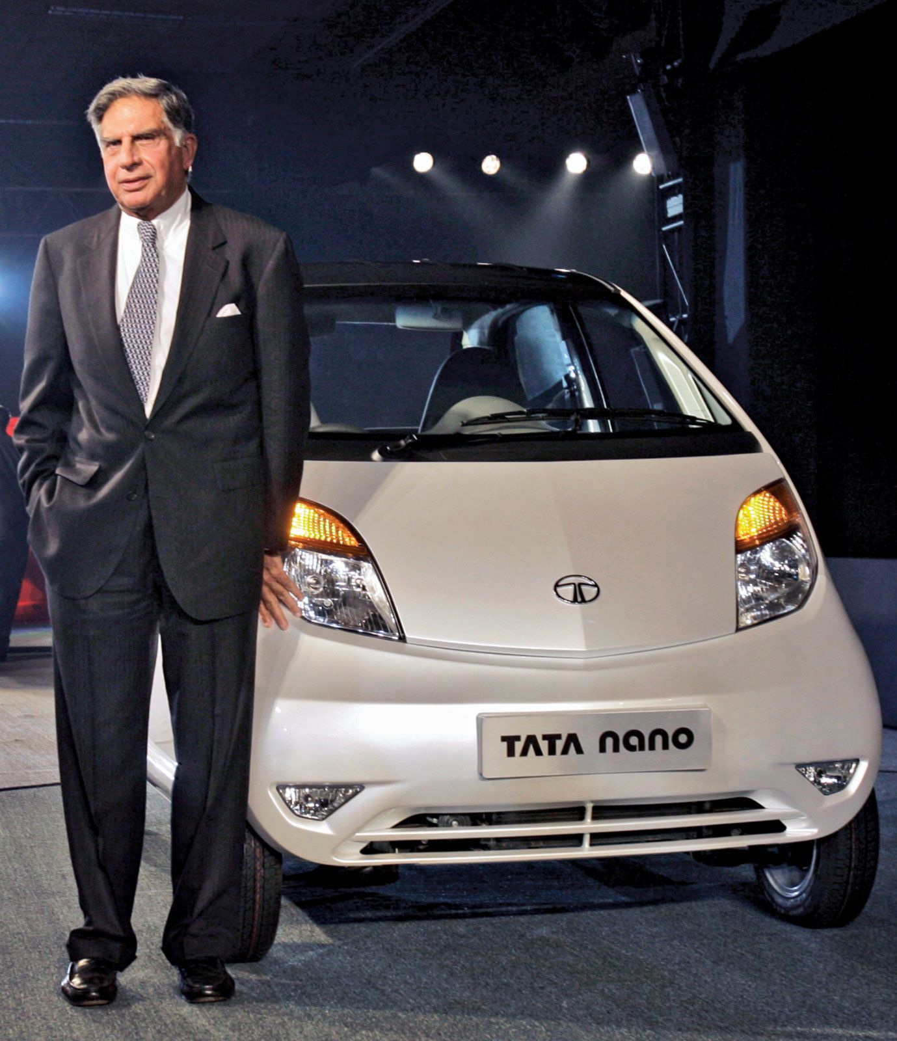



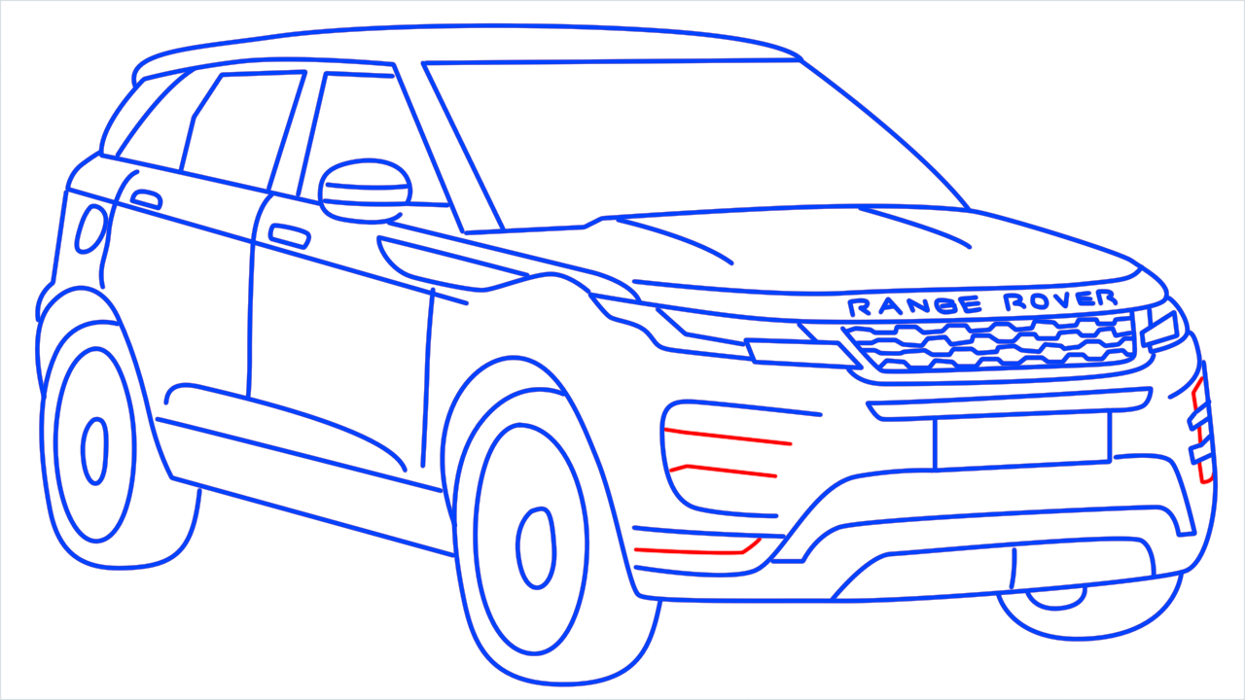

26/11 Response
Tata Nano Project
Jaguar Land Rover Acquisition
Tetley Tea Acquisition
The Tata Nano was created as a response to the growing demand for affordable personal transport in India. Ratan Tata aimed to provide a car that could be easily accessed by the middle class, who often preferred two-wheelers like scooters. The Nano was designed to be a practical and cost-effective solution for families, offering a safe and enclosed space for four to five passengers. Despite its initial success, the Nano faced challenges such as safety concerns, marketing failures, and a perception of low quality.
During the tragic 26/11 Mumbai attacks, Ratan Tata demonstrated quiet yet powerful leadership. He personally stood outside the Taj Mahal Palace Hotel for days, overseeing relief efforts and visiting victims and employees without seeking publicity. He went to hospitals and even the homes of those affected, offering support and ensuring long‑term aid through Tata Group initiatives. His response reflected humility and compassion, showing that true leadership is not about grand gestures but about standing with people in their darkest times.
Tata acquired Tetley in February 2000 for £271 million. This acquisition made Tetley a wholly owned subsidiary of Tata Consumer Products, enhancing Tata's global tea operations.
This helps Tata to:
Expansion into the global market
Increased market share
Enhanced product offerings
Improved brand reputation
Cost efficiency
The Tata Jaguar Land Rover acquisition, valued at approximately $2.3 billion, marked a watershed moment for both Tata Motors and the global automotive industry.
This case study in corporate strategy and foresight exemplifies how a visionary leader, Ratan Tata, recognized an opportunity to elevate Tata Motors onto the global stage by acquiring two iconic British brands.
04
03
02
01

Slide 17
26/11 Response
Tata Nano Project
Jaguar Land Rover Acquisition
Tetley Tea Acquisition
The Tata Nano was created as a response to the growing demand for affordable personal transport in India. Ratan Tata aimed to provide a car that could be easily accessed by the middle class, who often preferred two-wheelers like scooters. The Nano was designed to be a practical and cost-effective solution for families, offering a safe and enclosed space for four to five passengers. Despite its initial success, the Nano faced challenges such as safety concerns, marketing failures, and a perception of low quality.
During the tragic 26/11 Mumbai attacks, Ratan Tata demonstrated quiet yet powerful leadership. He personally stood outside the Taj Mahal Palace Hotel for days, overseeing relief efforts and visiting victims and employees without seeking publicity. He went to hospitals and even the homes of those affected, offering support and ensuring long‑term aid through Tata Group initiatives. His response reflected humility and compassion, showing that true leadership is not about grand gestures but about standing with people in their darkest times.
Tata acquired Tetley in February 2000 for £271 million. This acquisition made Tetley a wholly owned subsidiary of Tata Consumer Products, enhancing Tata's global tea operations.
This helps Tata to:
Expansion into the global market
Increased market share
Enhanced product offerings
Improved brand reputation
Cost efficiency
The Tata Jaguar Land Rover acquisition, valued at approximately $2.3 billion, marked a watershed moment for both Tata Motors and the global automotive industry.
This case study in corporate strategy and foresight exemplifies how a visionary leader, Ratan Tata, recognized an opportunity to elevate Tata Motors onto the global stage by acquiring two iconic British brands.
04
03
02
01
Notes:
26 November 2008 Taj Mahal Palace Hotel
Oberoi Trident Hotel
Chhatrapati Shivaji Terminus (CST)
Leopold Café
Nariman House

Slide 18
26/11 Response
Tata Nano Project
Jaguar Land Rover Acquisition
Tetley Tea Acquisition
The Tata Nano was created as a response to the growing demand for affordable personal transport in India. Ratan Tata aimed to provide a car that could be easily accessed by the middle class, who often preferred two-wheelers like scooters. The Nano was designed to be a practical and cost-effective solution for families, offering a safe and enclosed space for four to five passengers. Despite its initial success, the Nano faced challenges such as safety concerns, marketing failures, and a perception of low quality.
During the tragic 26/11 Mumbai attacks, Ratan Tata demonstrated quiet yet powerful leadership. He personally stood outside the Taj Mahal Palace Hotel for days, overseeing relief efforts and visiting victims and employees without seeking publicity. He went to hospitals and even the homes of those affected, offering support and ensuring long‑term aid through Tata Group initiatives. His response reflected humility and compassion, showing that true leadership is not about grand gestures but about standing with people in their darkest times.
Tata acquired Tetley in February 2000 for £271 million. This acquisition made Tetley a wholly owned subsidiary of Tata Consumer Products, enhancing Tata's global tea operations.
This helps Tata to:
Expansion into the global market
Increased market share
Enhanced product offerings
Improved brand reputation
Cost efficiency
The Tata Jaguar Land Rover acquisition, valued at approximately $2.3 billion, marked a watershed moment for both Tata Motors and the global automotive industry.
This case study in corporate strategy and foresight exemplifies how a visionary leader, Ratan Tata, recognized an opportunity to elevate Tata Motors onto the global stage by acquiring two iconic British brands.
04
03
02
01
Notes:
26 November 2008 Taj Mahal Palace Hotel
Oberoi Trident Hotel
Chhatrapati Shivaji Terminus (CST)
Leopold Café
Nariman House

Slide 19
26/11 Response
Jaguar Land Rover Acquisition
Tetley Tea Acquisition
Tata Nano Project
During the tragic 26/11 Mumbai attacks, Ratan Tata demonstrated quiet yet powerful leadership. He personally stood outside the Taj Mahal Palace Hotel for days, overseeing relief efforts and visiting victims and employees without seeking publicity. He went to hospitals and even the homes of those affected, offering support and ensuring long‑term aid through Tata Group initiatives. His response reflected humility and compassion, showing that true leadership is not about grand gestures but about standing with people in their darkest times.
The Tata Nano was created as a response to the growing demand for affordable personal transport in India. Ratan Tata aimed to provide a car that could be easily accessed by the middle class, who often preferred two-wheelers like scooters. The Nano was designed to be a practical and cost-effective solution for families, offering a safe and enclosed space for four to five passengers. Despite its initial success, the Nano faced challenges such as safety concerns, marketing failures, and a perception of low quality.
Tata acquired Tetley in February 2000 for £271 million. This acquisition made Tetley a wholly owned subsidiary of Tata Consumer Products, enhancing Tata's global tea operations.
This helps Tata to:
Expansion into the global market
Increased market share
Enhanced product offerings
Improved brand reputation
Cost efficiency
The Tata Jaguar Land Rover acquisition, valued at approximately $2.3 billion, marked a watershed moment for both Tata Motors and the global automotive industry.
This case study in corporate strategy and foresight exemplifies how a visionary leader, Ratan Tata, recognized an opportunity to elevate Tata Motors onto the global stage by acquiring two iconic British brands.
04
03
02
01
Notes:
26 November 2008 Taj Mahal Palace Hotel
Oberoi Trident Hotel
Chhatrapati Shivaji Terminus (CST)
Leopold Café
Nariman House

Slide 20
26/11 Response
Jaguar Land Rover Acquisition
Tata Nano Project
Tetley Tea Acquisition
During the tragic 26/11 Mumbai attacks, Ratan Tata demonstrated quiet yet powerful leadership. He personally stood outside the Taj Mahal Palace Hotel for days, overseeing relief efforts and visiting victims and employees without seeking publicity. He went to hospitals and even the homes of those affected, offering support and ensuring long‑term aid through Tata Group initiatives. His response reflected humility and compassion, showing that true leadership is not about grand gestures but about standing with people in their darkest times.
The Tata Nano was created as a response to the growing demand for affordable personal transport in India. Ratan Tata aimed to provide a car that could be easily accessed by the middle class, who often preferred two-wheelers like scooters. The Nano was designed to be a practical and cost-effective solution for families, offering a safe and enclosed space for four to five passengers. Despite its initial success, the Nano faced challenges such as safety concerns, marketing failures, and a perception of low quality.
The Tata Jaguar Land Rover acquisition, valued at approximately $2.3 billion, marked a watershed moment for both Tata Motors and the global automotive industry.
This case study in corporate strategy and foresight exemplifies how a visionary leader, Ratan Tata, recognized an opportunity to elevate Tata Motors onto the global stage by acquiring two iconic British brands.
Tata acquired Tetley in February 2000 for £271 million. This acquisition made Tetley a wholly owned subsidiary of Tata Consumer Products, enhancing Tata's global tea operations.
This helps Tata to:
Expansion into the global market
Increased market share
Enhanced product offerings
Improved brand reputation
Cost efficiency
04
03
02
01
Notes:
26 November 2008 Taj Mahal Palace Hotel
Oberoi Trident Hotel
Chhatrapati Shivaji Terminus (CST)
Leopold Café
Nariman House

Slide 21
26/11 Response
Jaguar Land Rover Acquisition
Tata Nano Project
Tetley Tea Acquisition
The Tata Nano was created as a response to the growing demand for affordable personal transport in India. Ratan Tata aimed to provide a car that could be easily accessed by the middle class, who often preferred two-wheelers like scooters. The Nano was designed to be a practical and cost-effective solution for families, offering a safe and enclosed space for four to five passengers. Despite its initial success, the Nano faced challenges such as safety concerns, marketing failures, and a perception of low quality.
During the tragic 26/11 Mumbai attacks, Ratan Tata demonstrated quiet yet powerful leadership. He personally stood outside the Taj Mahal Palace Hotel for days, overseeing relief efforts and visiting victims and employees without seeking publicity. He went to hospitals and even the homes of those affected, offering support and ensuring long‑term aid through Tata Group initiatives. His response reflected humility and compassion, showing that true leadership is not about grand gestures but about standing with people in their darkest times.
The Tata Jaguar Land Rover acquisition, valued at approximately $2.3 billion, marked a watershed moment for both Tata Motors and the global automotive industry.
This case study in corporate strategy and foresight exemplifies how a visionary leader, Ratan Tata, recognized an opportunity to elevate Tata Motors onto the global stage by acquiring two iconic British brands.
Tata acquired Tetley in February 2000 for £271 million. This acquisition made Tetley a wholly owned subsidiary of Tata Consumer Products, enhancing Tata's global tea operations.
This helps Tata to:
Expansion into the global market
Increased market share
Enhanced product offerings
Improved brand reputation
Cost efficiency
04
03
02
01
Notes:
26 November 2008 Taj Mahal Palace Hotel
Oberoi Trident Hotel
Chhatrapati Shivaji Terminus (CST)
Leopold Café
Nariman House

Slide 22
26/11 Response
Tata Nano Project
Jaguar Land Rover Acquisition
Tetley Tea Acquisition
The Tata Nano was created as a response to the growing demand for affordable personal transport in India. Ratan Tata aimed to provide a car that could be easily accessed by the middle class, who often preferred two-wheelers like scooters. The Nano was designed to be a practical and cost-effective solution for families, offering a safe and enclosed space for four to five passengers. Despite its initial success, the Nano faced challenges such as safety concerns, marketing failures, and a perception of low quality.
During the tragic 26/11 Mumbai attacks, Ratan Tata demonstrated quiet yet powerful leadership. He personally stood outside the Taj Mahal Palace Hotel for days, overseeing relief efforts and visiting victims and employees without seeking publicity. He went to hospitals and even the homes of those affected, offering support and ensuring long‑term aid through Tata Group initiatives. His response reflected humility and compassion, showing that true leadership is not about grand gestures but about standing with people in their darkest times.
Tata acquired Tetley in February 2000 for £271 million. This acquisition made Tetley a wholly owned subsidiary of Tata Consumer Products, enhancing Tata's global tea operations.
This helps Tata to:
Expansion into the global market
Increased market share
Enhanced product offerings
Improved brand reputation
Cost efficiency
The Tata Jaguar Land Rover acquisition, valued at approximately $2.3 billion, marked a watershed moment for both Tata Motors and the global automotive industry.
This case study in corporate strategy and foresight exemplifies how a visionary leader, Ratan Tata, recognized an opportunity to elevate Tata Motors onto the global stage by acquiring two iconic British brands.
04
03
02
01
Notes:
26 November 2008 Taj Mahal Palace Hotel
Oberoi Trident Hotel
Chhatrapati Shivaji Terminus (CST)
Leopold Café
Nariman House

Slide 23
26/11 Response
Tata Nano Project
Jaguar Land Rover Acquisition
Tetley Tea Acquisition
The Tata Nano was created as a response to the growing demand for affordable personal transport in India. Ratan Tata aimed to provide a car that could be easily accessed by the middle class, who often preferred two-wheelers like scooters. The Nano was designed to be a practical and cost-effective solution for families, offering a safe and enclosed space for four to five passengers. Despite its initial success, the Nano faced challenges such as safety concerns, marketing failures, and a perception of low quality.
During the tragic 26/11 Mumbai attacks, Ratan Tata demonstrated quiet yet powerful leadership. He personally stood outside the Taj Mahal Palace Hotel for days, overseeing relief efforts and visiting victims and employees without seeking publicity. He went to hospitals and even the homes of those affected, offering support and ensuring long‑term aid through Tata Group initiatives. His response reflected humility and compassion, showing that true leadership is not about grand gestures but about standing with people in their darkest times.
Tata acquired Tetley in February 2000 for £271 million. This acquisition made Tetley a wholly owned subsidiary of Tata Consumer Products, enhancing Tata's global tea operations.
This helps Tata to:
Expansion into the global market
Increased market share
Enhanced product offerings
Improved brand reputation
Cost efficiency
The Tata Jaguar Land Rover acquisition, valued at approximately $2.3 billion, marked a watershed moment for both Tata Motors and the global automotive industry.
This case study in corporate strategy and foresight exemplifies how a visionary leader, Ratan Tata, recognized an opportunity to elevate Tata Motors onto the global stage by acquiring two iconic British brands.
04
03
02
01

Slide 24

Table of Contents
04
05
01
02
Put People First From employees to communities, he prioritized human welfare over profits.
Stay Resilient in Crisis His calm and compassionate response during 26/11 showed strength in adversity.
Lead with Humility True leadership is about staying grounded, not showing off power or wealth.
Actions Speak Louder than Words He showed that quiet, meaningful actions create more impact than publicity.
03
Think Long‑Term His decisions, like global acquisitions, were made with future growth in mind.

Slide 25
Lessons We Can Learn
01
02
03
04
05
Lead with Humility True leadership is about staying grounded, not showing off power or wealth.
Actions Speak Louder than Words He showed that quiet, meaningful actions create more impact than publicity.
Think Long‑Term His decisions, like global acquisitions, were made with future growth in mind.
Put People First From employees to communities, he prioritized human welfare over profits.
Stay Resilient in Crisis His calm and compassionate response during 26/11 showed strength in adversity.

Slide 26
01
Lead with Humility True leadership is about staying grounded, not showing off power or wealth.
02
03
04
05
Actions Speak Louder than Words He showed that quiet, meaningful actions create more impact than publicity.
Think Long‑Term His decisions, like global acquisitions, were made with future growth in mind.
Put People First From employees to communities, he prioritized human welfare over profits.
Stay Resilient in Crisis His calm and compassionate response during 26/11 showed strength in adversity.

Slide 27
02
Actions Speak Louder than Words He showed that quiet, meaningful actions create more impact than publicity.
01
03
04
05
Lead with Humility True leadership is about staying grounded, not showing off power or wealth.
Think Long‑Term His decisions, like global acquisitions, were made with future growth in mind.
Put People First From employees to communities, he prioritized human welfare over profits.
Stay Resilient in Crisis His calm and compassionate response during 26/11 showed strength in adversity.

Slide 28
03
Think Long‑Term His decisions, like global acquisitions, were made with future growth in mind.
01
02
04
05
Lead with Humility True leadership is about staying grounded, not showing off power or wealth.
Actions Speak Louder than Words He showed that quiet, meaningful actions create more impact than publicity.
Put People First From employees to communities, he prioritized human welfare over profits.
Stay Resilient in Crisis His calm and compassionate response during 26/11 showed strength in adversity.

Slide 29
04
Put People First From employees to communities, he prioritized human welfare over profits.
01
02
03
05
Lead with Humility True leadership is about staying grounded, not showing off power or wealth.
Actions Speak Louder than Words He showed that quiet, meaningful actions create more impact than publicity.
Think Long‑Term His decisions, like global acquisitions, were made with future growth in mind.
Stay Resilient in Crisis His calm and compassionate response during 26/11 showed strength in adversity.

Slide 30
05
Stay Resilient in Crisis His calm and compassionate response during 26/11 showed strength in adversity.
01
02
03
04
Lead with Humility True leadership is about staying grounded, not showing off power or wealth.
Actions Speak Louder than Words He showed that quiet, meaningful actions create more impact than publicity.
Think Long‑Term His decisions, like global acquisitions, were made with future growth in mind.
Put People First From employees to communities, he prioritized human welfare over profits.

Slide 31
Lessons We Can Learn
01
02
03
04
05
Lead with Humility True leadership is about staying grounded, not showing off power or wealth.
Actions Speak Louder than Words He showed that quiet, meaningful actions create more impact than publicity.
Think Long‑Term His decisions, like global acquisitions, were made with future growth in mind.
Put People First From employees to communities, he prioritized human welfare over profits.
Stay Resilient in Crisis His calm and compassionate response during 26/11 showed strength in adversity.

Slide 32
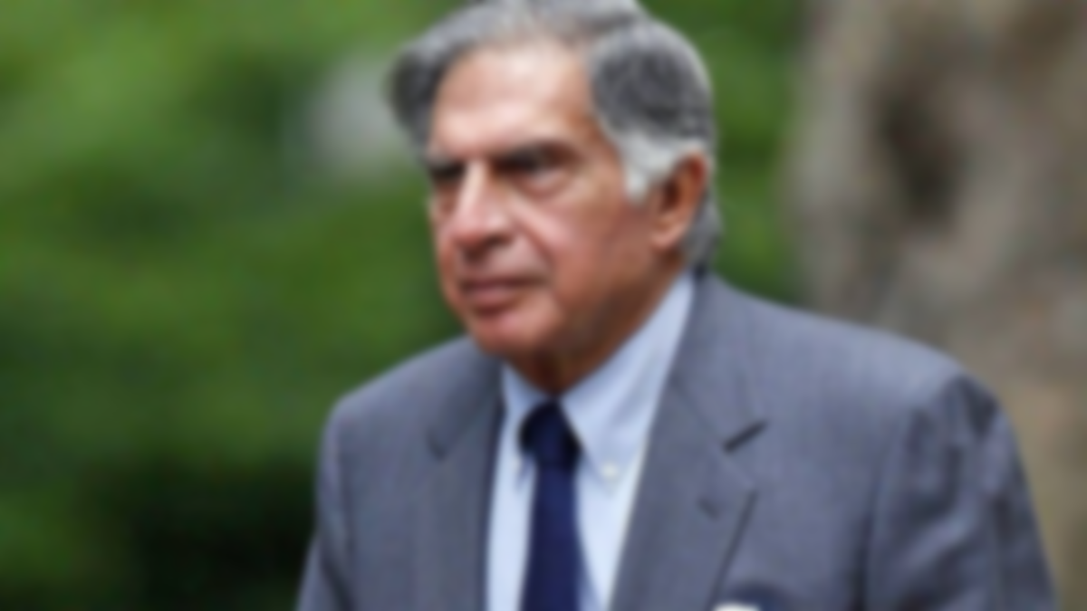
“
“If you want to walk fast, walk alone. But if you want to walk far, walk together”
-Ratan Tata

Slide 33






Sources
Vecteezy
Flaticon
Mobile data - Free arrows icons
User - Free people icons
Target - Free marketing icons
Example - Free education icons
Lesson - Free education icons
Youtube.com
PowerPoint Slide Zoom Tutorial
PRO Animated PowerPoint Presentation
Animated PowerPoint Slide Tutorial
Tata Jaguar and Land Rover Acquisition Unveiled A Journey of Automotive Mastery - TmbTata Motors
Freepik.com
Briefcase Generic Glyph icon | Freepik
Background abstract line digital design gradient template | Free Vector

Slide 34


By Vardaan

